Slide 1
BANK MANAGEMENT SYSTEM
TEAM: Why Axis? (Group 3)

Slide 2
Problem Statement
Banks are the main sources of monetary support to those in need as these financial institutions receive deposits and provide loans to a variety of audiences from big corporate organizations to an ordinary man. This entire process of two and forth monetary support should be managed in an efficient manner to be beneficial and ensure seamless functioning.
The main function of a bank management system is to permit banks and their credit institutions to carry out their business processes. They focus on managing basic transactions, offering loads, mortgages, ATM payments and mobile net banking. Our system will store extensive details about the customer, bank accounts, loans, and the bank employee.

Slide 3
Objectives
A bank management system is created to assist banks in managing different facets of their business, including account management, transaction processing, financial reporting, and compliance. A bank management system's primary goal is to:
Automate and streamline banking processes
Provide accurate and current information
Enhance customer service
Compliance
Risk administration
Analytics and reporting
Security

Slide 4
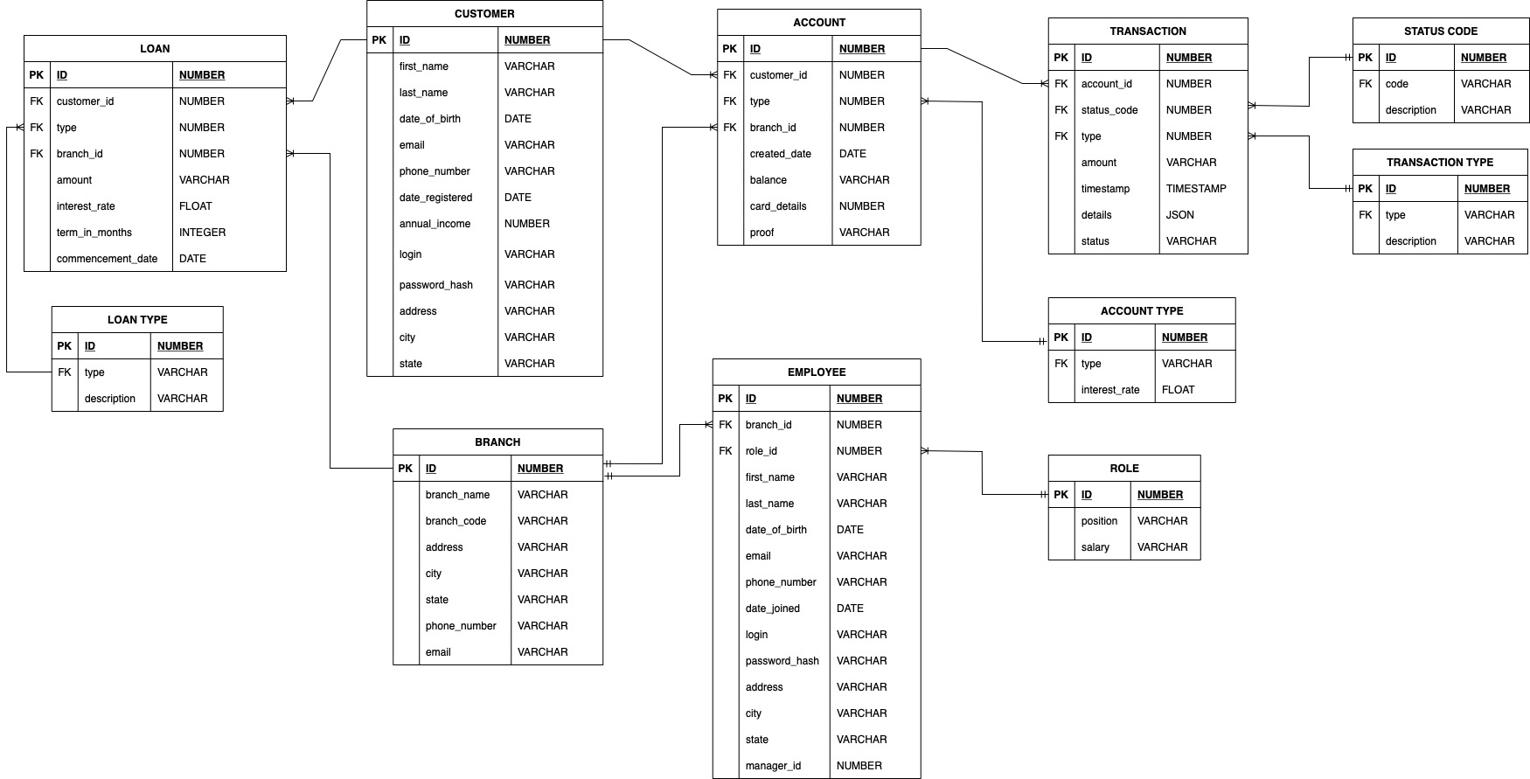
ER DIAGRAM

Slide 5
Tables (In Order of Creation)
CUSTOMER: Stores customer personal and contact details.
BRANCH: Holds information about bank branches.
LOAN_TYPE: Contains different types of loans and descriptions.
LOAN: Stores loan details and associations with customers and branches.
ACCOUNT_TYPE: Contains different account types and interest rates.
ACCOUNTS: Stores account information and customer associations.
ROLE_TABLE: Holds employee positions and salaries.
EMPLOYEE: Contains employee personal and contact details, roles, and branch associations.
STATUS_CODE: Stores transaction status codes and descriptions.
TRANSACTION_TYPE: Holds transaction types and descriptions.
TRANSACTION_TABLE: Stores transaction details, types, and account associations.

Slide 6
Views
V_AGG_HOURLY_TRANSACTIONS_BY_TYPE: Aggregates hourly transactions by type, excluding failed transactions.
V_HOURLY_FAILED_TRANSACTION: Lists all failed transactions within the last hour.
V_AGG_DAILY_TRANSACTIONS_BY_TYPE: Aggregates daily transactions by type, excluding failed transactions.
V_DAILY_FAILED_TRANSACTIONS: Lists all failed transactions within the last day.
V_AGG_DAILY_TRANSACTIONS_BY_BRANCH: Aggregates daily transactions by branch
V_AGG_DAILY_FAILED_TRANSACTIONS_BY_BRANCH: Aggregates daily failed transactions by branch.
V_AGG_HOURLY_TRANSACTIONS_BY_BRANCH: Aggregates hourly transactions by branch
V_AGG_HOURLY_FAILED_TRANSACTIONS_BY_BRANCH: Aggregates hourly failed transactions by branch.
V_CUSTOMER_ACCOUNT_BALANCES: Lists customer information with account balances and account types.
V_ACCOUNTS_BRANCH_INFO: Lists all accounts with branch information including branch name and code.
V_TRANSACTION_DETAILS: Lists detailed transaction information, grouped by customer.
V_LOANS_CUSTOMER_INFO: Lists loans with customer and branch information, as well as loan type descriptions.
V_EMPLOYEE_POSITION_INFO: Lists employees with position, branch, and manager information.
V_OVERDRAFT_ACCOUNTS: Lists accounts currently in overdraft status.
V_AGG_OVERDRAFT_ACCOUNTS_BY_BRANCH: Aggregates overdraft accounts by branch.

Slide 7
Triggers
transaction_success_debit: Deducts transaction amount for successful withdrawals and bill payments.
transaction_success_receive: Adds transaction amount for successful incoming transfers.
transaction_success_transfer: Deducts transaction amount for successful outgoing transfers.
transaction_success_credit: Adds transaction amount for successful deposits.
transaction_failure: Prints an error message for various failed transaction scenarios.

Slide 8
Procedures
ADD_NEW_BRANCH: Inserts branch data, ensuring no duplicates in the BRANCH table.
ADD_NEW_LOAN_TYPE: Adds a loan type with a description, checking for uniqueness in the LOAN_TYPE table.
ADD_NEW_ACCOUNT_TYPE: Registers a new account type and interest rate, verifying its singularity in the ACCOUNT_TYPE table.
ADD_NEW_ROLE: Creates a new role with an associated salary, ensuring the role does not already exist in the ROLE_TABLE.
ADD_NEW_STATUS_CODE: Appends a status code with a description, checking for pre-existence in the STATUS_CODE table.
ADD_NEW_TRANSACTION_TYPE: Adds a transaction type with its description, confirming it is not already present in the TRANSACTION_TYPE table.

Slide 9
Functions
GET_TOTAL_LOAN_AMOUNT: Returns the total loan amount for a given customer.
GET_ACCOUNT_BALANCE: Retrieves the total account balance for a specific customer.
GET_CUSTOMER_FULL_NAME: Returns the full name of a customer based on their customer ID.
GET_EMPLOYEE_FULL_NAME: Provides the full name of an employee using their employee ID.
GET_CUSTOMER_LOAN_COUNT: Determines the total number of loans a customer has.
IS_BALANCE_SUFFICIENT: Checks if the balance of an account is sufficient for a given amount.
GET_EMPLOYEE_COUNT_BY_BRANCH: Returns the number of employees in a particular branch.
GET_ACCOUNT_COUNT_BY_TYPE: Retrieves the total number of accounts for a specific account type.

Slide 10
Packages (Database Admin)
CUSTOMER_MGMT_PKG: Contains procedures and functions to manage customer information, such as adding new customers, updating customer details, and retrieving customer account and loan information.
EMPLOYEE_MGMT_PKG: Handles employee management, including adding new employees, updating employee details, and retrieving employees based on specific criteria such as employee ID or role.
ACCOUNT_MGMT_PKG: Manages bank accounts, providing functionality for adding new accounts, checking account existence, retrieving account balance, and obtaining bank statements and recent transactions.
LOAN_MGMT_PKG: Deals with loan management, allowing for loan existence checks, retrieving loan details, and adding or updating loans.
TRANSACTION_MGMT_PKG: Manages transactions, offering procedures to add new transactions and retrieve transaction details for a specific transaction.

Slide 11
Packages (Users)
EMPLOYEE_PKG: This package contains procedures that an employee would use in their daily work routine, such as viewing customer and account details, managing customer data, handling account transactions, and dealing with loans.
MANAGER_PKG: This package contains procedures for managers, which include all the procedures from EMPLOYEE_PKG, plus additional procedures for adding and updating employee data. Managers have the ability to manage both customer and employee data, as well as perform tasks from the employee package.
CUSTOMER_PKG: This package contains procedures that customers can use to access their account information, such as viewing their own customer information, account details, transactions, and loans. This package also provides procedures for viewing recent transactions by account ID, the latest 5 transactions, and the last transaction, both for specific accounts and all accounts linked to a customer.

Slide 12
Separating procedures based on user roles improves data security in several ways:
Principle of Least Privilege: By following the principle of least privilege, each role has access only to the procedures necessary for their tasks. This reduces the risk of unauthorized access or misuse of sensitive information. For example, customers will not have access to procedures intended for employees or managers, ensuring that they can only view and manage their own information.
Easier Access Control: Separating procedures into role-specific packages makes it easier to manage access control and permissions. You can grant or revoke privileges on a package level, reducing the chances of accidentally granting excessive privileges to a user or role. This simplifies the process of maintaining a secure system and reduces the likelihood of human error.
Simplified Code Maintenance: Organizing procedures into role-based packages makes the code more modular and easier to maintain. This can lead to better security practices, as it is easier to identify potential vulnerabilities and address them in a timely manner. It also makes it easier to audit the code and ensure that security requirements are being met.
Enhanced Monitoring and Auditing: Separating procedures by role can help improve the monitoring and auditing process. By tracking which package is being accessed and by whom, you can identify unusual patterns of behavior or unauthorized access attempts. This can help detect potential security threats or breaches and allows for quicker response to any issues that arise.

Slide 13
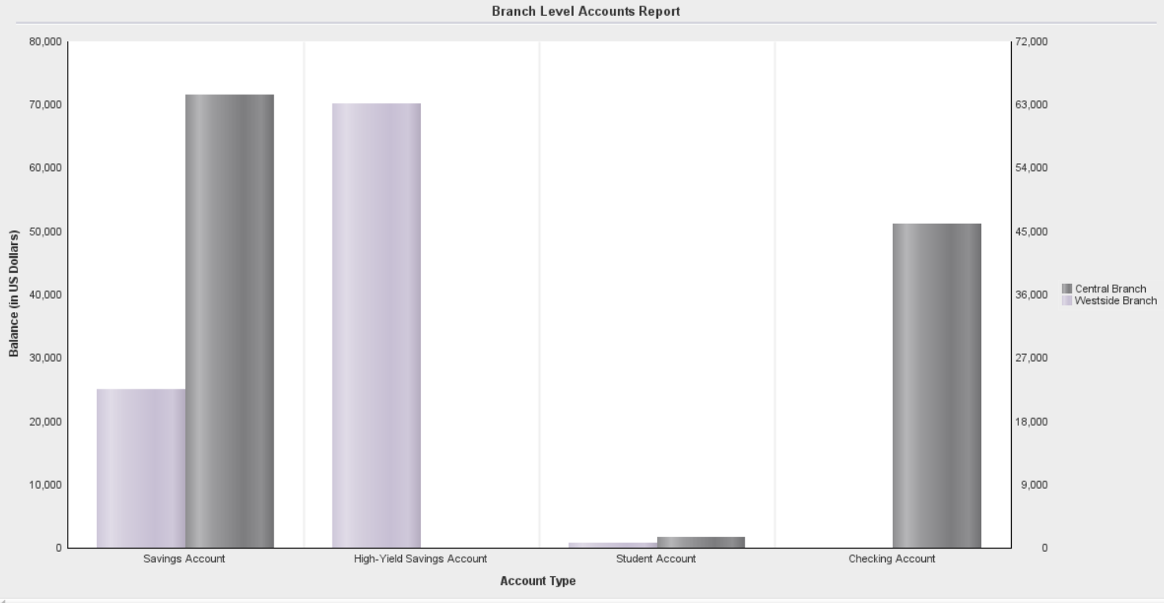
Reports
1) Branch Level Accounts Report:
This report provides a summary of account balances for each branch, broken down by account type. It shows the total balance for each account type in each branch.

Slide 14
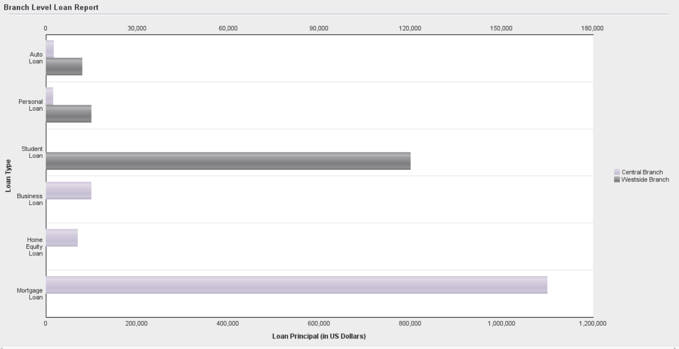
Reports
2) Branch Level Loan Report:
This report shows a summary of loan amounts and average loan terms (in months) for each branch, broken down by loan type. This helps to understand the distribution of loan types and their terms across branches.

Slide 15
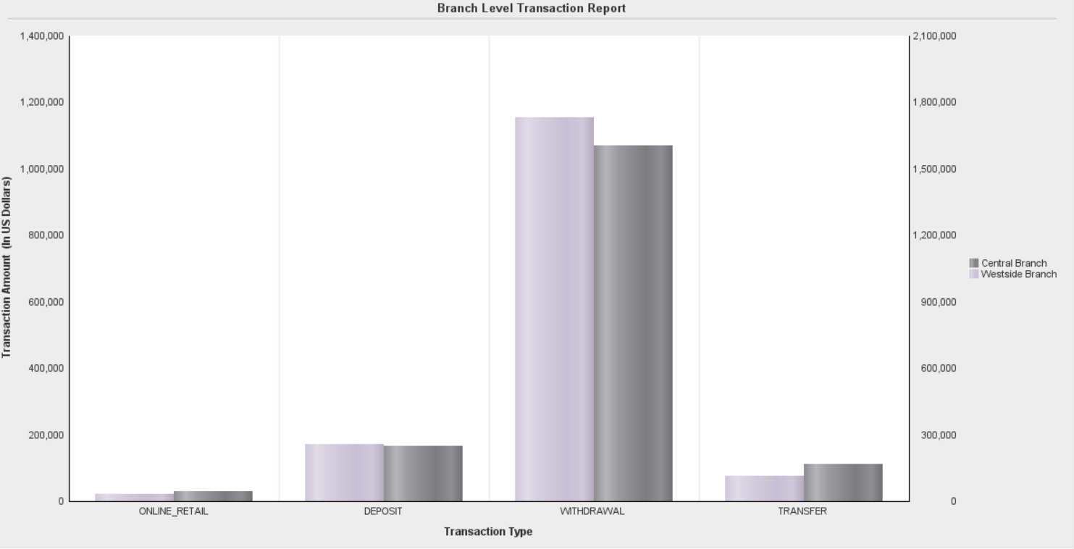
Reports
3) Branch Level Transaction Report:
This report provides a summary of transaction amounts for each branch, broken down by transaction type. It helps to analyze the distribution of transactions by type across different branches.

Slide 16
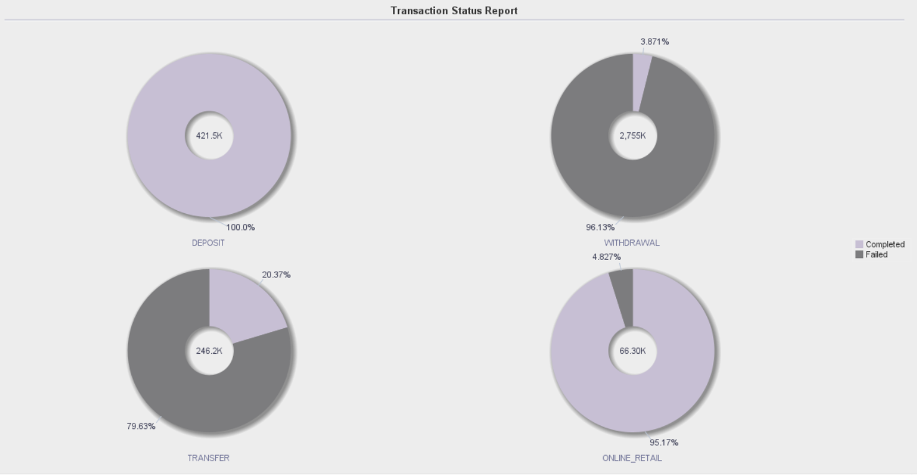
Reports
4) Transaction Status Report - Transaction Type Breakdown:
This report shows the total transaction amount, broken down by transaction type and status (e.g., successful or failed). This can be useful for analyzing the performance and reliability of different transaction types.

Slide 17
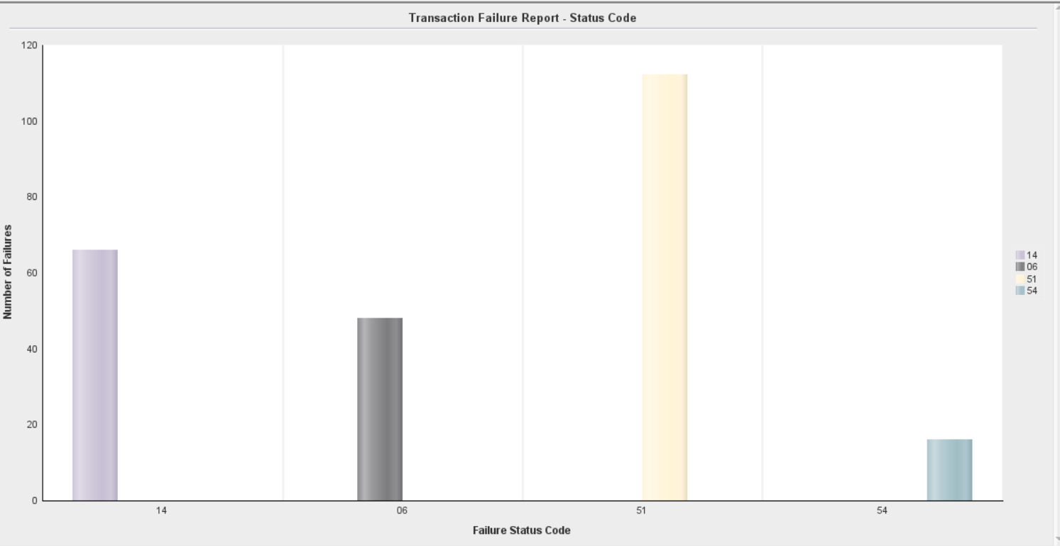
Reports
5) Failed Transaction Status Report - Status code Breakdown:
This report provides a summary of failed transactions, broken down by their status codes. It can help identify common reasons for transaction failures and potentially address any issues.

Slide 18
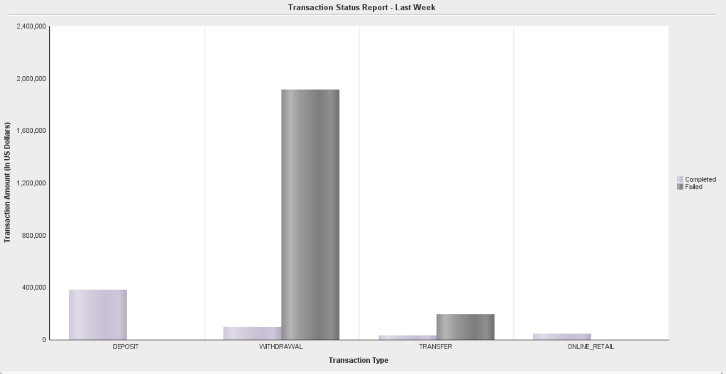
Reports
6) Transaction Status Report - Last Week & Transaction Type Breakdown:
This report shows a summary of transaction amounts for the last week, broken down by transaction type and status. It can help to identify any recent trends or issues in transaction processing.

Slide 19
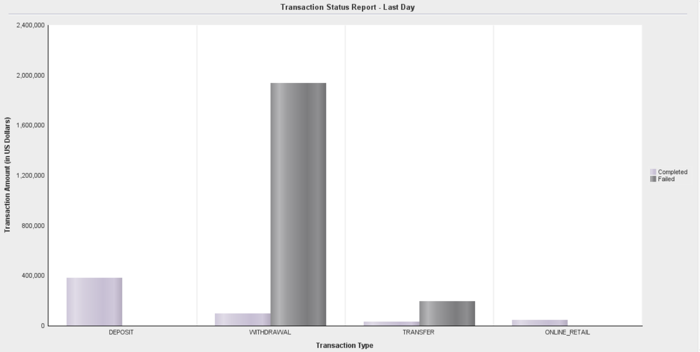
Reports
7) Transaction Status Report - Last Day & Transaction Type Breakdown:
This report provides a summary of transaction amounts for the last day, broken down by transaction type and status. It can be useful for monitoring daily transaction activity and identifying any potential issues that may have occurred recently.

Slide 20
Individual Contribution
NAME | CONTRIBUTION
Gopi Krishna Gorle (002644080) | Responsible for creating indexes, generating reports, managing user privileges, performing object cleanup, and authoring the GitHub README;
Lakshman Raaj Senthil Nathan (002737381) | Developed PL/SQL triggers, views, procedures, functions, and packages; inserted records into the database, enhancing its organization and structure.
Lokeshwaran Venugopal Balamurugan (002990533) | Created tables, sequences, and records; performed object clean-ups; developed PL/SQL procedures, functions, and packages; authored SQL scripts for user creation, database administration, and various user types; prepared the PowerPoint presentation; and authored the GitHub README.
Krishica Gopalakrishnan (002762173) | Created PL/SQL functions, procedures, and packages; inserted records into the database; contributed to the PowerPoint presentation.
Vidisha Shetty (002966340) | Created PL/SQL functions, procedures, and packages; inserted records into the database; contributed to the PowerPoint presentation.

Slide 21
THANK YOU!

